Slide 1
ECE5584 – Digital Image Processing Homework 2, Problem 1 Fall 2019
By Matthew Kayrish

Slide 2

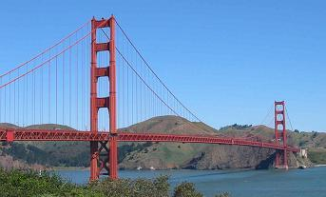
Problem 1: Filter Noisy Images
Original Images
Golden Gate Bridge
American Flag

Slide 3
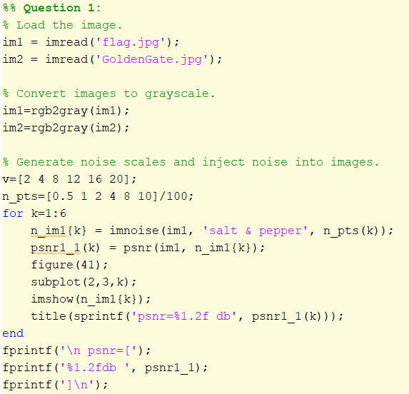
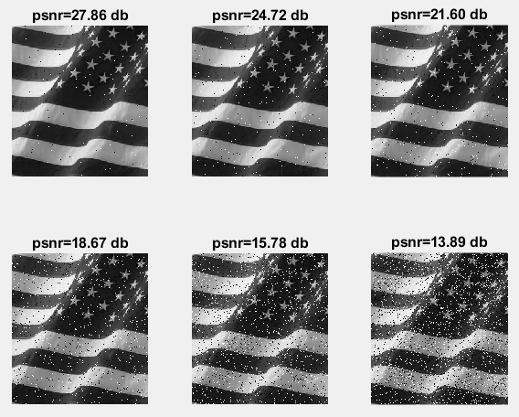
Problem 1: Filter Noisy Images
”Filter the noisy images generated using the following code.”
Step 1: Generate Noisy Images

Slide 4
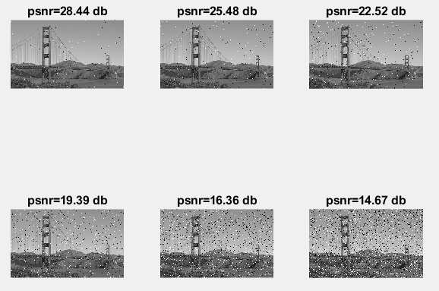
Problem 1: Filter Noisy Images
”Filter the noisy images generated using the following code.”
Step 1: Generate Noisy Images

Slide 5
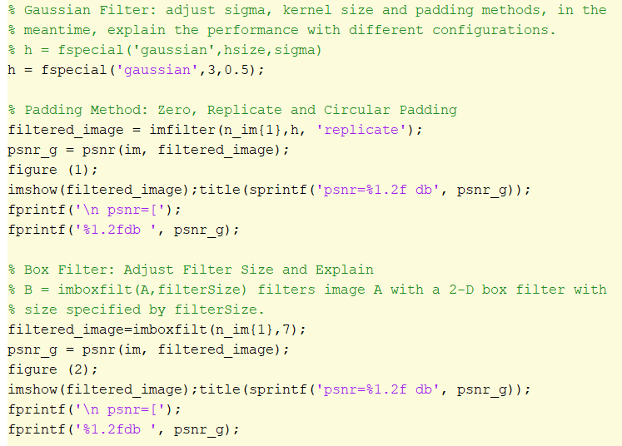
Problem 1: Filter Noisy Images
”Compare the results using zero padding, replicate padding and circular padding”
Step 2: Compare the results using different padding and filtration methods.

Slide 6
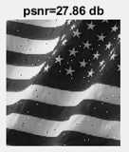
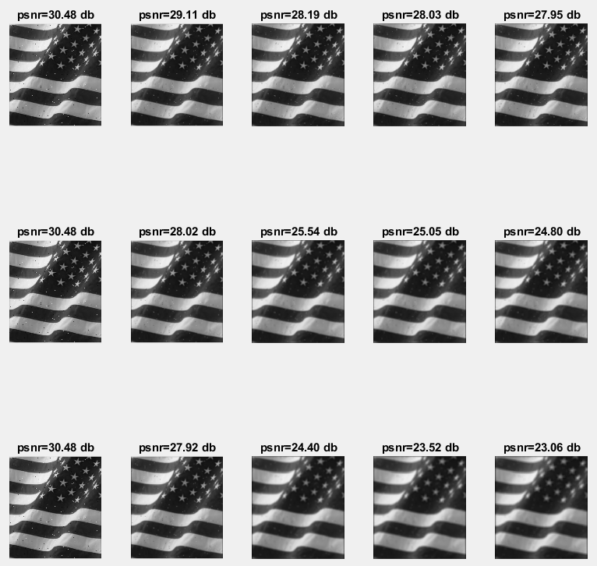
Problem 1: Filter Noisy Images – Zero Padding
After Filtering
Filter Size: 3x3
Before Filtering
Filter Size: 5x5
Filter Size: 7x7
Sigma: 0.5 1.0 2.0 3.0 5.0

Slide 7
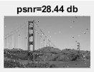
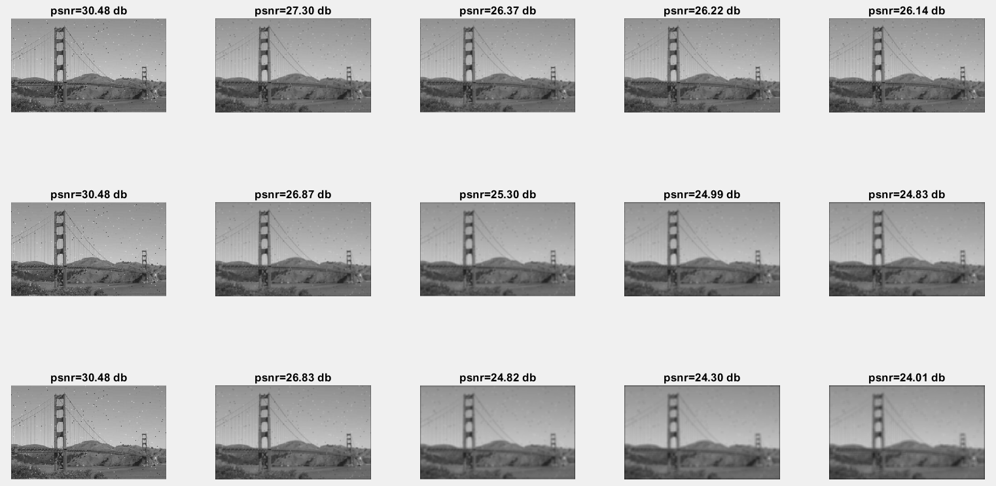
Problem 1: Filter Noisy Images – Zero Padding
Before Filtering
After Filtering
Filter Size: 3x3
Filter Size: 5x5
Filter Size: 7x7
Sigma: 0.5 1.0 2.0 3.0 5.0

Slide 8
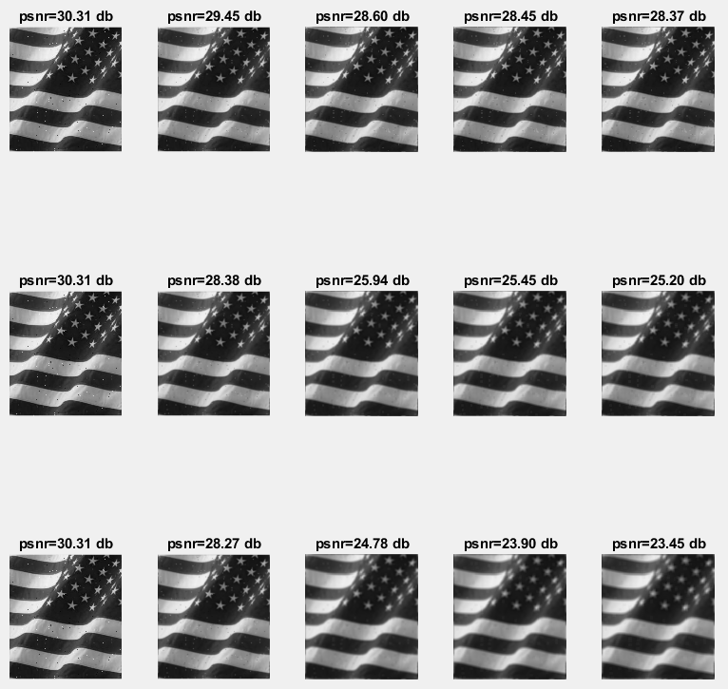
Problem 1: Filter Noisy Images – Circular Padding
After Filtering
Filter Size: 3x3
Before Filtering
Filter Size: 5x5
Filter Size: 7x7
Sigma: 0.5 1.0 2.0 3.0 5.0

Slide 9
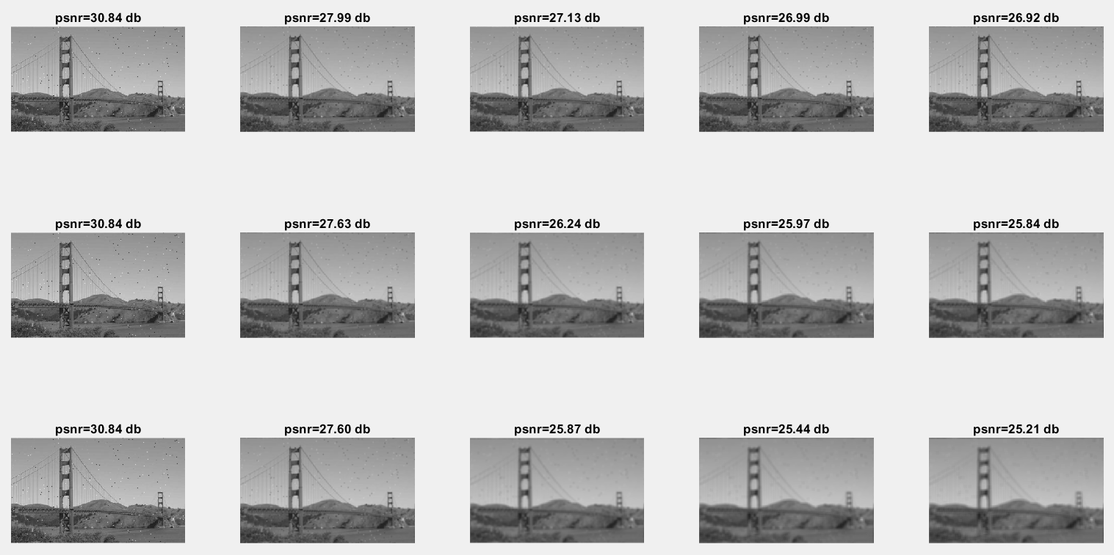
Problem 1: Filter Noisy Images – Circular Padding
Before Filtering
After Filtering
Filter Size: 3x3
Filter Size: 5x5
Filter Size: 7x7
Sigma: 0.5 1.0 2.0 3.0 5.0

Slide 10
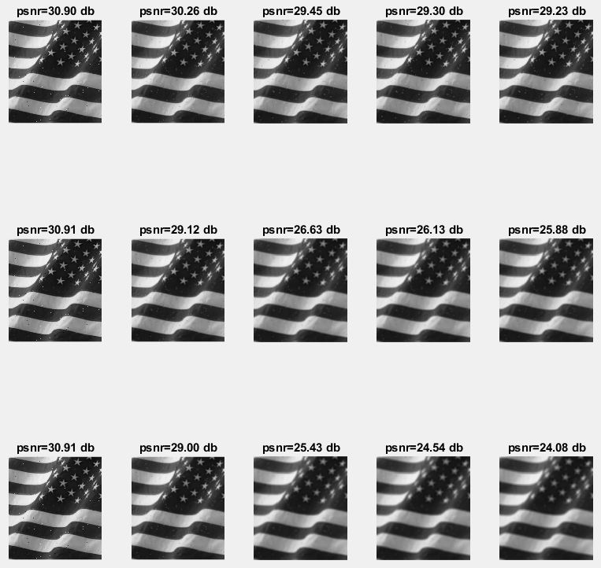
Problem 1: Filter Noisy Images – Replicate Padding
After Filtering
Filter Size: 3x3
Before Filtering
Filter Size: 5x5
Filter Size: 7x7
Sigma: 0.5 1.0 2.0 3.0 5.0

Slide 11
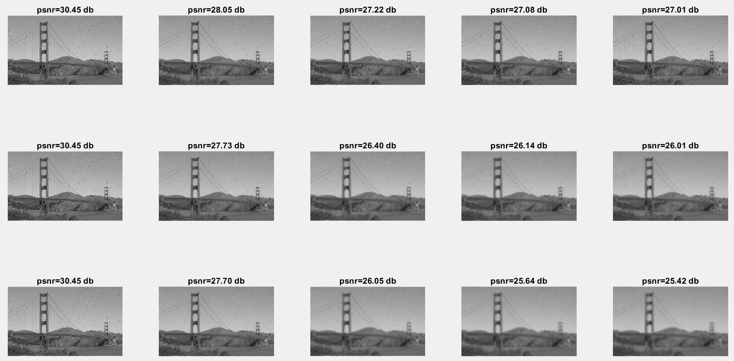
Problem 1: Filter Noisy Images – Replicate Padding
Before Filtering
After Filtering
Filter Size: 3x3
Filter Size: 5x5
Filter Size: 7x7
Sigma: 0.5 1.0 2.0 3.0 5.0

Slide 12
Problem 1: Before and After – 0.5% Noise
After Filtering
Filter Size: 3x3
Before Filtering
Filter Size: 5x5
Filter Size: 7x7
Sigma: 0.5 1.0 2.0 3.0 5.0

Slide 13
Problem 1: Before and After – 0.5% Noise
Before Filtering
After Filtering
Filter Size: 3x3
Filter Size: 5x5
Filter Size: 7x7
Sigma: 0.5 1.0 2.0 3.0 5.0

Slide 14
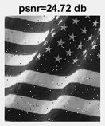
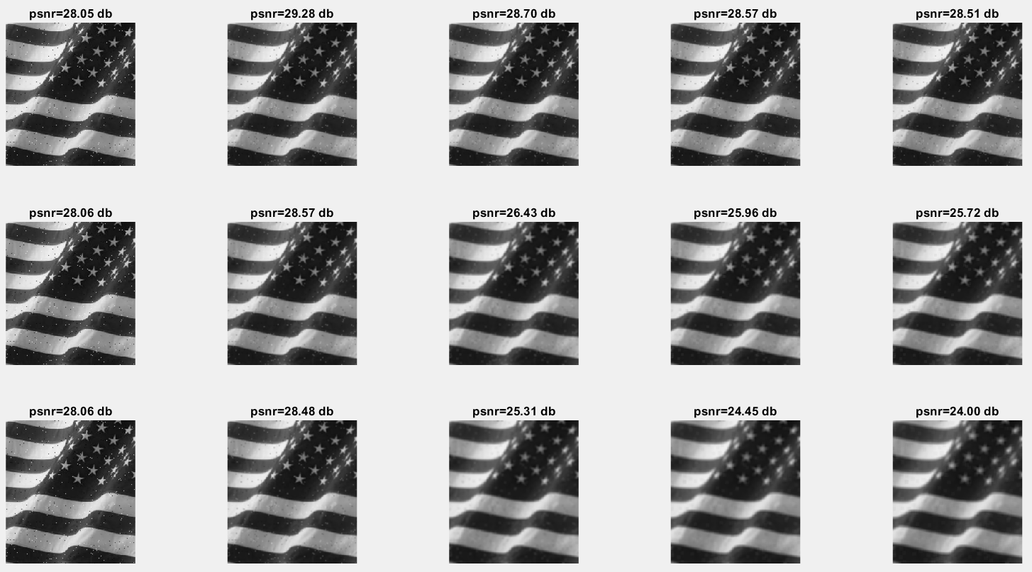
Problem 1: Before and After – 1.0% Noise
After Filtering
Before Filtering
Filter Size: 3x3
Filter Size: 5x5
Filter Size: 7x7
Sigma: 0.5 1.0 2.0 3.0 5.0

Slide 15
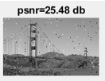
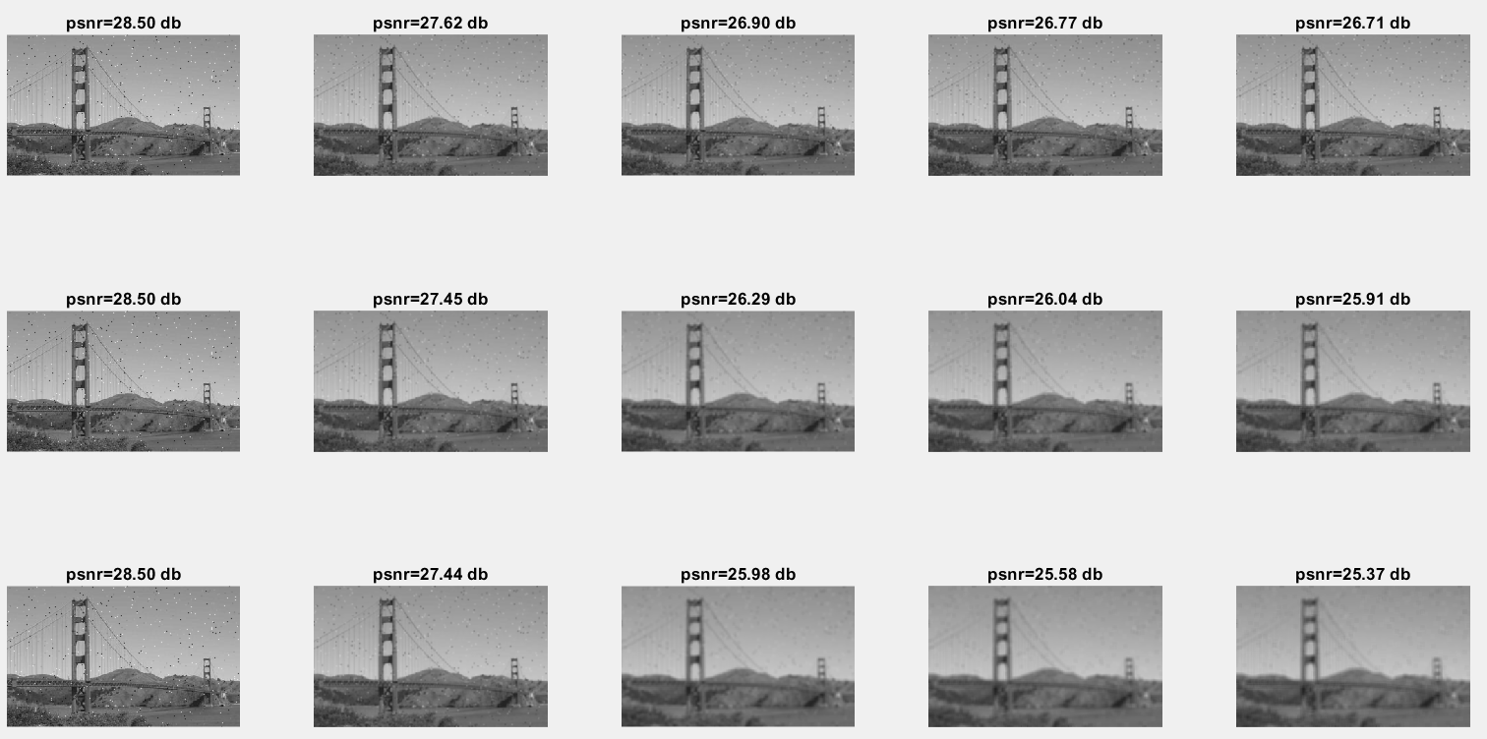
Problem 1: Before and After – 1.0% Noise
After Filtering
Before Filtering
Filter Size: 3x3
Filter Size: 5x5
Filter Size: 7x7
Sigma: 0.5 1.0 2.0 3.0 5.0

Slide 16
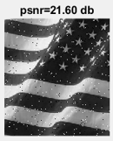
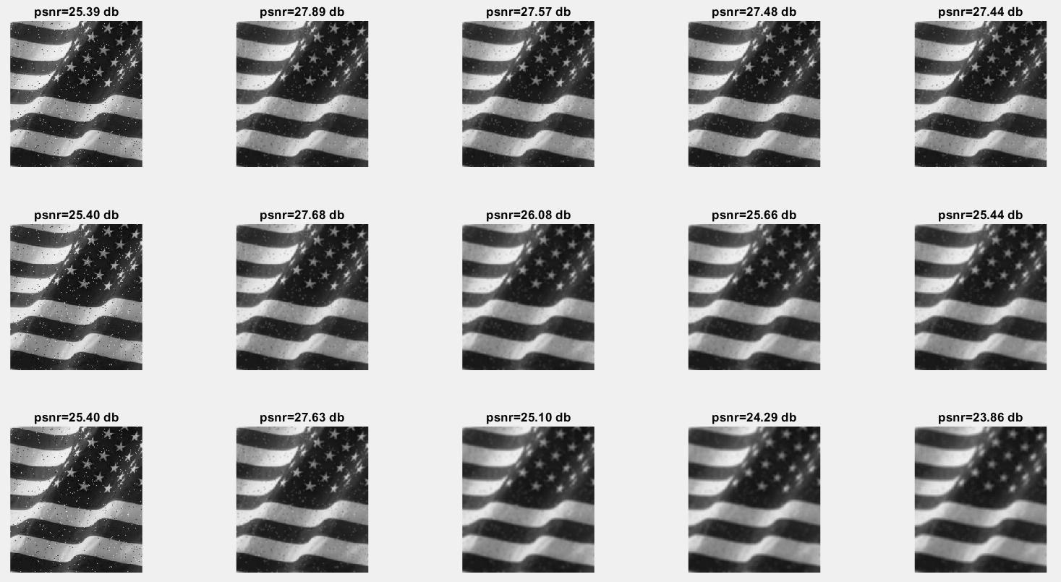
Problem 1: Before and After – 2.0% Noise
After Filtering
Before Filtering
Filter Size: 3x3
Filter Size: 5x5
Filter Size: 7x7
Sigma: 0.5 1.0 2.0 3.0 5.0

Slide 17
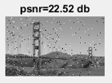
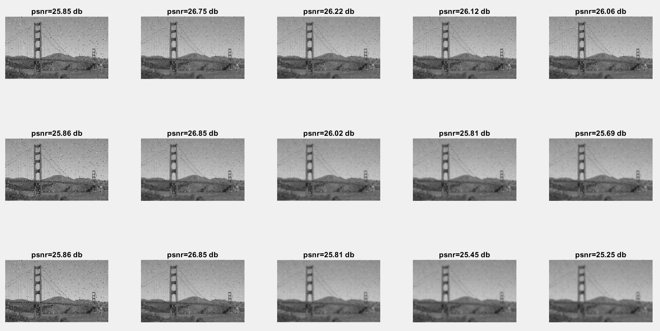
Problem 1: Before and After – 2.0% Noise
After Filtering
Before Filtering
Filter Size: 3x3
Filter Size: 5x5
Filter Size: 7x7
Sigma: 0.5 1.0 2.0 3.0 5.0

Slide 18
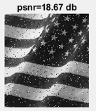
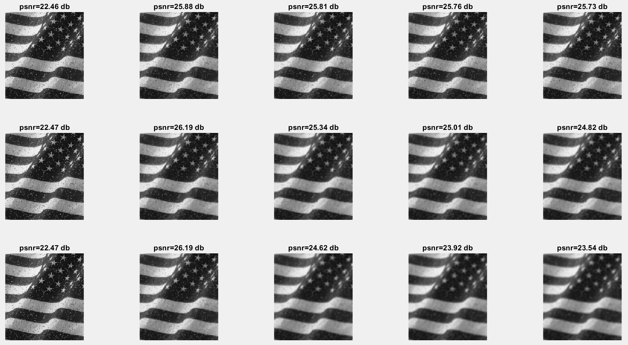
Problem 1: Before and After – 4.0% Noise
After Filtering
Before Filtering
Filter Size: 3x3
Filter Size: 5x5
Filter Size: 7x7
Sigma: 0.5 1.0 2.0 3.0 5.0

Slide 19
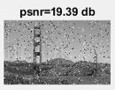
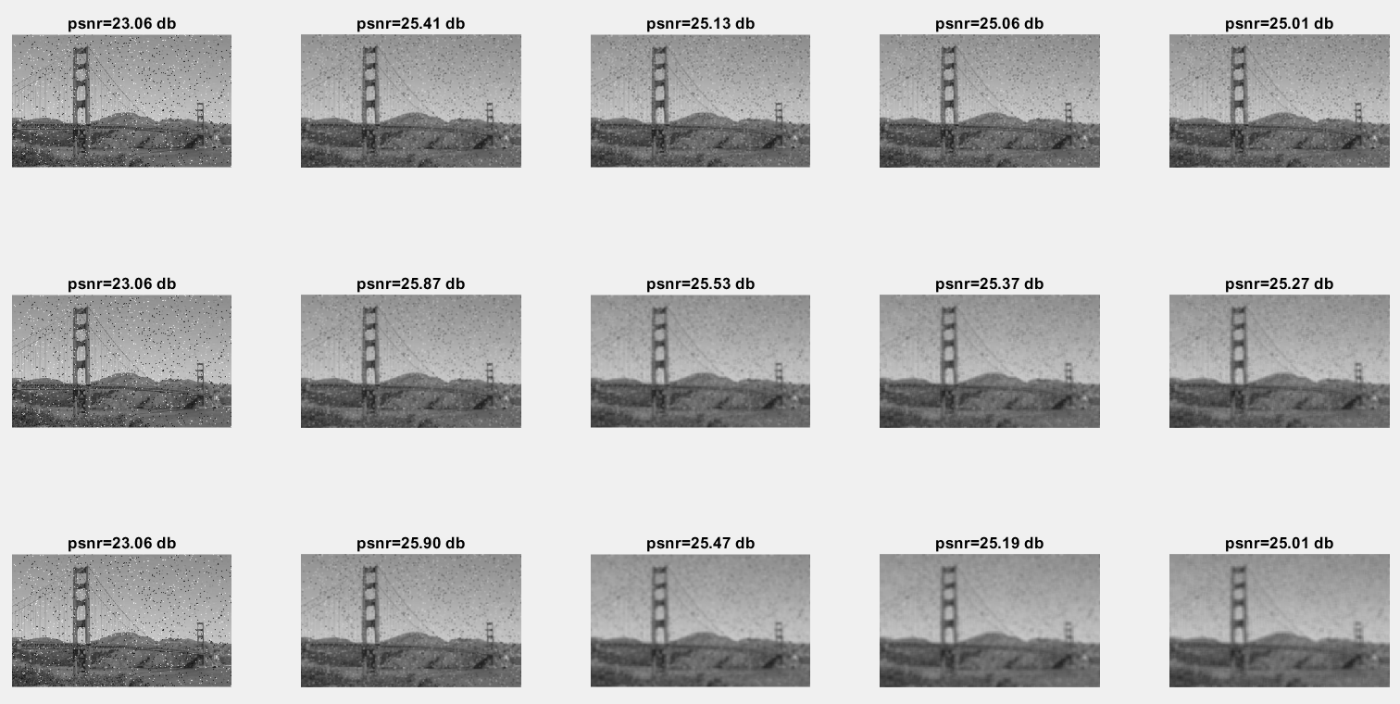
Problem 1: Before and After – 4.0% Noise
After Filtering
Before Filtering
Filter Size: 3x3
Filter Size: 5x5
Filter Size: 7x7
Sigma: 0.5 1.0 2.0 3.0 5.0

Slide 20
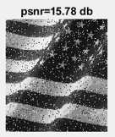
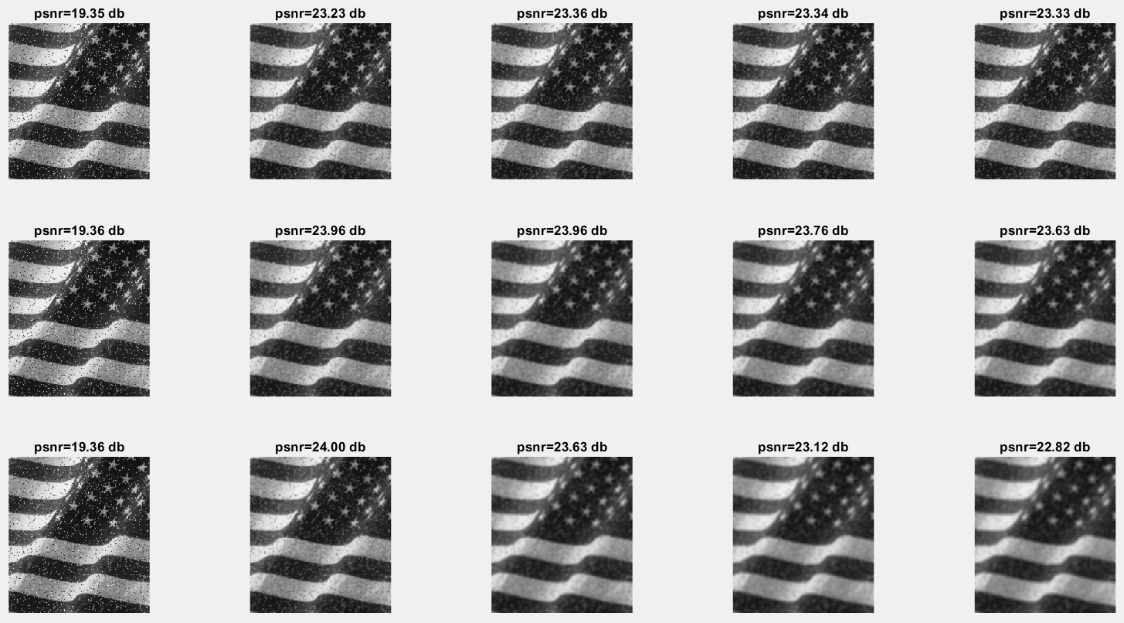
Problem 1: Before and After – 8.0% Noise
After Filtering
Before Filtering
Filter Size: 3x3
Filter Size: 5x5
Filter Size: 7x7
Sigma: 0.5 1.0 2.0 3.0 5.0

Slide 21
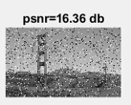

Problem 1: Before and After – 8.0% Noise
Before Filtering
After Filtering
Filter Size: 3x3
Filter Size: 5x5
Filter Size: 7x7
Sigma: 0.5 1.0 2.0 3.0 5.0

Slide 22
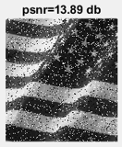
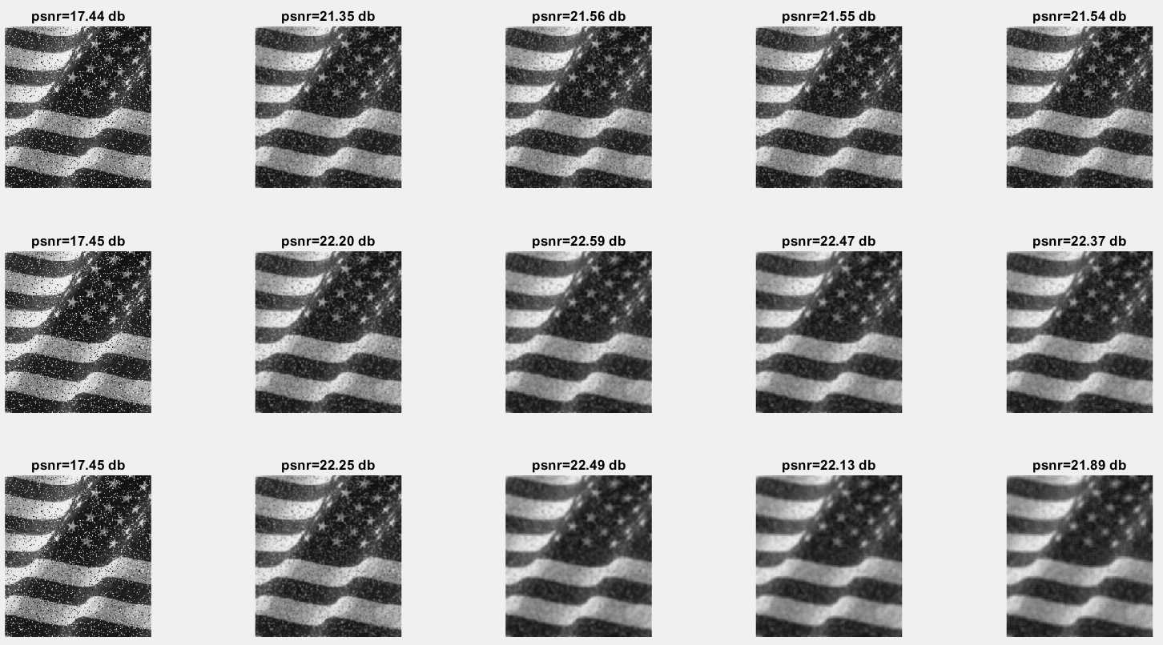
Problem 1: Before and After – 12.0% Noise
After Filtering
Before Filtering
Filter Size: 3x3
Filter Size: 5x5
Filter Size: 7x7
Sigma: 0.5 1.0 2.0 3.0 5.0

Slide 23
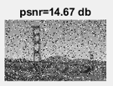

Problem 1: Before and After – 12.0% Noise
Before Filtering
After Filtering
Filter Size: 3x3
Filter Size: 5x5
Filter Size: 7x7
Sigma: 0.5 1.0 2.0 3.0 5.0

Slide 24
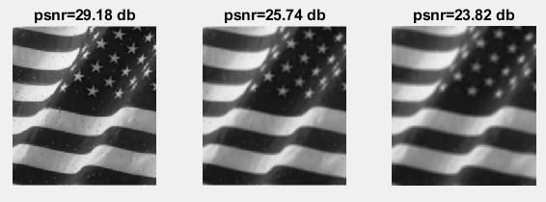
Problem 1: Before and After, Box Filter – 0.5% Noise
Before Filtering
After Filtering
Box Size: 3.0 5.0 7.0

Slide 25
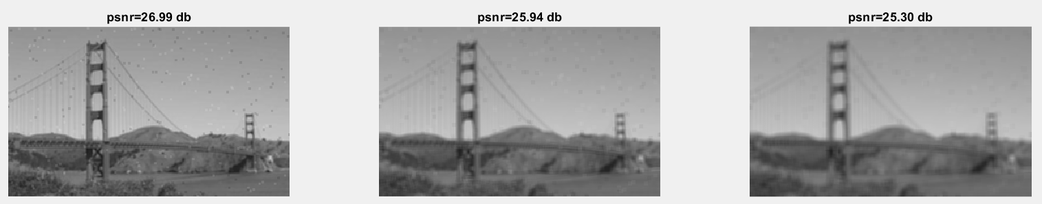
Problem 1: Before and After, Box Filter – 0.5% Noise
Before Filtering
After Filtering
Box Size: 3.0 5.0 7.0

Slide 26
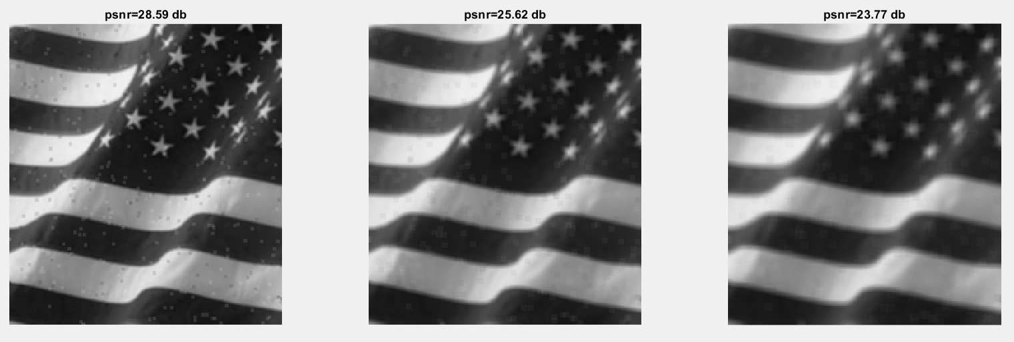
Problem 1: Before and After, Box Filter – 1.0% Noise
Before Filtering
After Filtering
Box Size: 3.0 5.0 7.0

Slide 27
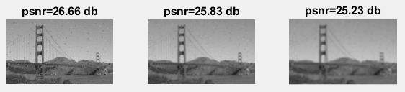
Problem 1: Before and After, Box Filter – 1.0% Noise
Before Filtering
After Filtering
Box Size: 3.0 5.0 7.0

Slide 28
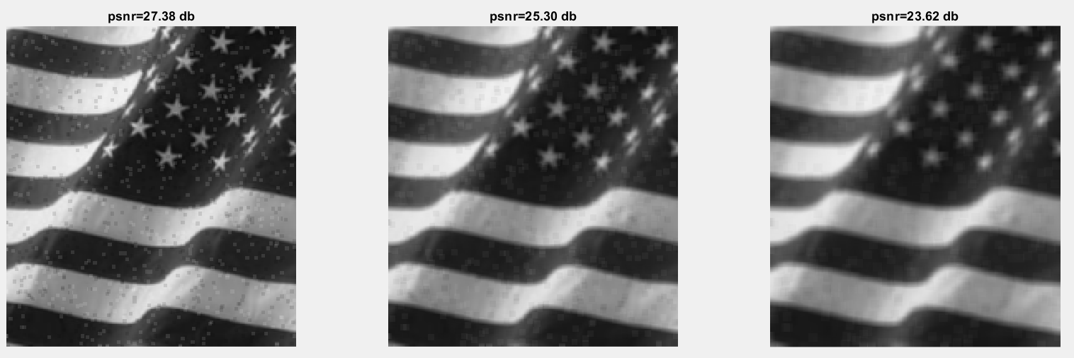
Problem 1: Before and After, Box Filter – 2.0% Noise
Before Filtering
After Filtering
Box Size: 3.0 5.0 7.0

Slide 29
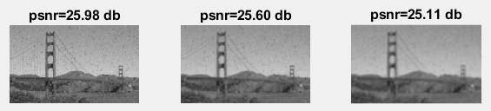
Problem 1: Before and After, Box Filter – 2.0% Noise
Before Filtering
After Filtering
Box Size: 3.0 5.0 7.0

Slide 30

Problem 1: Before and After, Box Filter – 4.0% Noise
Before Filtering
After Filtering
Box Size: 3.0 5.0 7.0

Slide 31
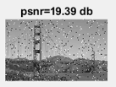
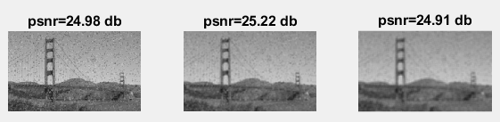
Problem 1: Before and After, Box Filter – 4.0% Noise
Before Filtering
After Filtering
Box Size: 3.0 5.0 7.0

Slide 32

Problem 1: Before and After, Box Filter – 8.0% Noise
Before Filtering
After Filtering
Box Size: 3.0 5.0 7.0

Slide 33
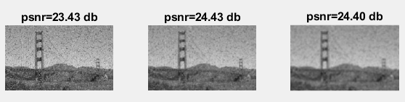
Problem 1: Before and After, Box Filter – 8.0% Noise
Before Filtering
After Filtering
Box Size: 3.0 5.0 7.0

Slide 34
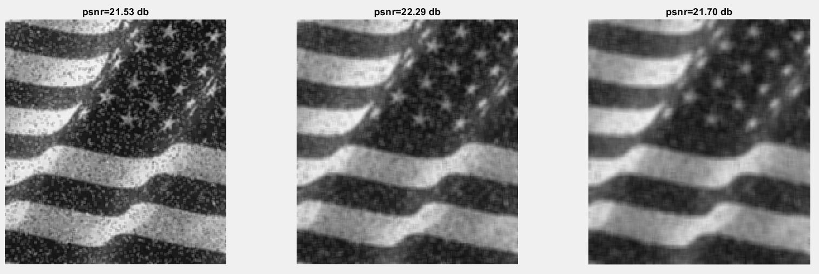
Problem 1: Before and After, Box Filter – 12.0% Noise
Before Filtering
After Filtering
Box Size: 3.0 5.0 7.0

Slide 35
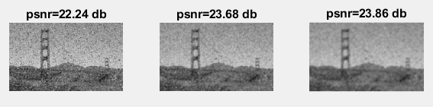
Problem 1: Before and After, Box Filter – 12.0% Noise
Before Filtering
After Filtering
Box Size: 3.0 5.0 7.0

Slide 36
Problem 1: Discussion – Padding Method
Gaussian Filter:
Padding Method: the padding method will impact the edge of the image.
Zero Padding: The edge pixels are blacked out
Circular Padding: Pads the edges with pixels from the other side of the image. This will only work if the image is symmetric. Else, it seems to create an ‘outline’ around the image.
Replicate Padding: Pads the edges with copies of the edge row. This method seems to work the best for creating a smooth image without losing much information.

Slide 37
Problem 1: Discussion – Kernel Size
Gaussian Filter:
Kernel Size: this impacts the size of the filter.
Larger Filters:
Create more of a smoothing effect
Better for removing imperfections
As Original SNR Increases, provides more effective filtering.
In general, not as good for maximizing SNR
Smaller Filter:
Maintain image integrity better than larger filters
Sharper than large filters with slightly less filtering
Does not perform as well as larger filters for very noisy images
Maintains signal to noise ratio better than large filters

Slide 38
Problem 1: Discussion – Sigma
Gaussian Filter:
Sigma: increases the spread of the filter.
Larger Sigma:
Create more of a smoothing effect
Better for removing imperfections
Worse for increasing signal to noise ratio
Smaller Sigma:
Provides a strong sharpening effect
May not remove all imperfections on the first pass filtering
Generally maintains a better signal to noise ratio than large sigma filters

Slide 39
Problem 1: Discussion – Box Filter
Box Filter: averages the neighboring pixels for the final value
Larger Box:
More effective for filtering very noisy images
Create more of a smoothing effect
Better for removing imperfections
Worse for increasing signal to noise ratio
Smaller Box:
Not as effective for very noisy images, however provides more of a sharpening effect
Provides less of a smoothing effect.
More susceptible to imperfections, but still removes some of them
Generally maintains a better signal to noise ratio than larger box filters

Slide 40
Problem 1: Comparison
Gaussian Filter
Box Filter
Larger filters are better for very noisy images
Smaller filters are better at sharpening images
As sigma increases, the smoothing effect also increases
As filter size increases, the smoothing effect also increases
Higher SNR with smaller sigma and filter size
Small Sigma creates a sharpening effect.
Larger filters are better for very noisy images
Smaller filters are better at sharpening images
Larger boxes have a larger smoothing effect
Smaller boxes have a higher SNR
Smaller boxes have less of a smoothing effect
Box filters will not create much of a sharpening effect.

